Slide 1
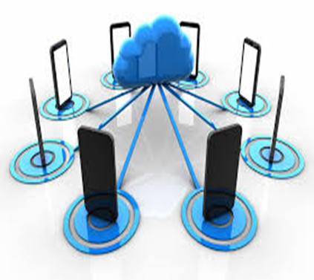
VSP : Virtual Smartphone Platform to Enhance the Capability of Physical Smartphones
Shobhit 19CS06008
Rohit Agarwal 19CS06002

Slide 2
Outline:
Introduction
System Architecture
Implementation
VS assignment problem
Evaluation Results
Conclusion

Slide 3
Introduction
VSP creates VSes for end users according to their configuration.
Thus, Low-end devices can provide complex applications with high quality.
Vses run on cloud and transfer screen data to physical device.
There exists isolation between VSes.
The security-mechanism of cloud provides a safer environment than before.

Slide 4
Difference between traditional VM & VS.
Compared to VM,VS is much more light weight.
So,with same resource(CPU,Servers),VSP can provide more VSes than VMs that general desktop virtualization or cloud provides

Slide 5
ARCHITECTURE AND SCENARIOS
SYSTEM FRAMEWORK
MANAGEMENT NODE
REMOTE CONTROL
SCENARIOS ANALYSIS

Slide 6
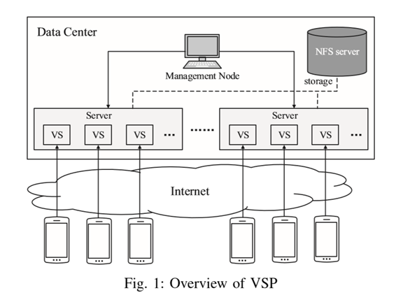
I. System Framework
VSes are running on remote servers
Users can own different VSes according to their demand
Client application of VSP is a thin client mobile application that runs on the general smartphones.

Slide 7
II. Management Node
Used to manage physical resources ie. server, storage
Sends query request to server
Helps in migrating VSes to proper server

Slide 8
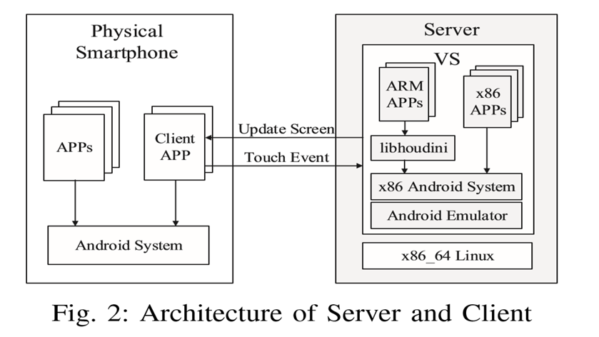
III. Remote Control

Slide 9
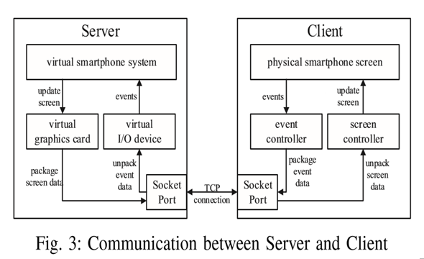

Slide 10
IV. Scenarios Analysis
Data protection
Sandbox
Remote Debug
Application Trial

Slide 11
Communication:
when client connect to the server
Server sends current protocol version to the client
If the client support this it will send back the same information
After the handshake , server sends the list of encoding method to client
Client shows the list of method to VSP users and sends back the choice
Server informs the client the screen resolution of VS

Slide 12
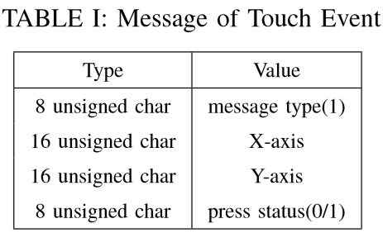
Message of touch events:

Slide 13
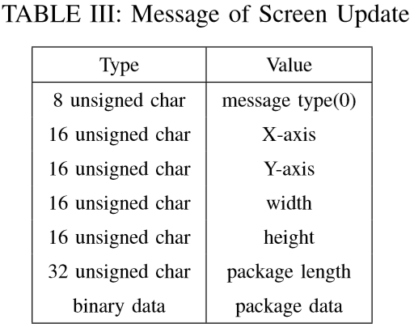
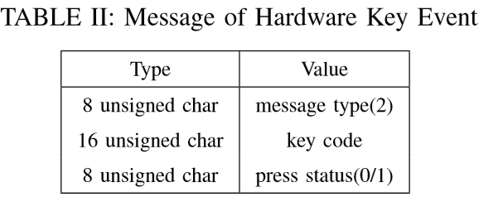
Hardware key event and screen update

Slide 14
Assigning Virtual SmartPhone :
VS assignment problem multi-dimensional , bin-packing .
Consider two dimensions for a server :
W_{pj} represents wastage of CPU.
W_{mj} represents wastage of Memory.
U_{mj} represents actual CPU utilization.
U_{pj} represents actual memory.
W_{pj} = T_{pj} - U_{pj}
W_{mj} = T_{mj} - U_{mj}

Slide 15
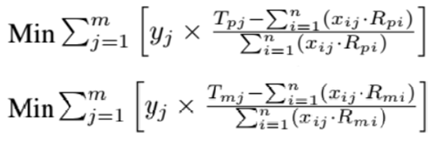
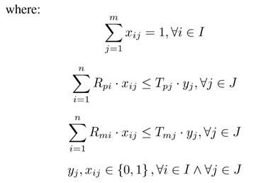
Assigning n VSes to
m Servers ,
R_{pi} represents actual performance value
R_{mi} represents actual memory value
y_{j} represents server status
x_{ij} represents assignment.

Slide 16
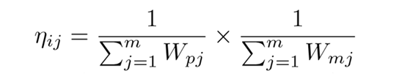
ReAssigning VS :
Why to reassign ?
Ant Colony Optimization .
Factors to be considered :
n_{ij} is the attractiveness.
T_{ij} is the trail level.
Next States depends on probability formulated by these factors.
n_{ij} is given by :

Slide 17
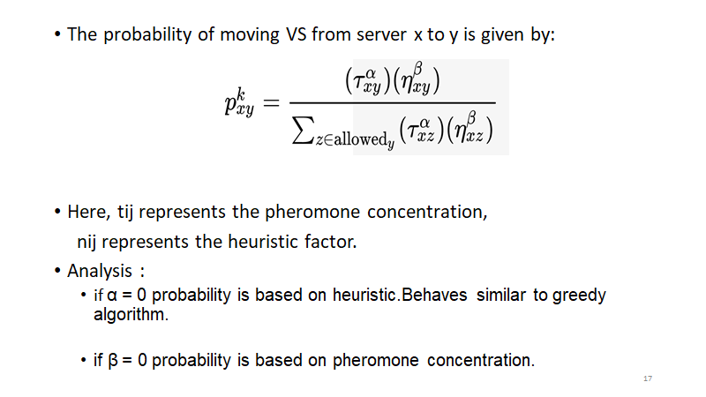

Slide 18
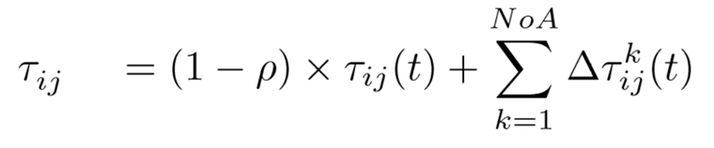
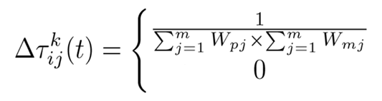
Pheromone concentration needs to be updated.
Here, 'ρ' represents the evaporation rate of pheromones.

Slide 19
Evaluation and Analysis :
CPU Utilisation
Bandwidth requirement
Battery Consumption
SLA Analysis
Virtual Smartphone Assignment

Slide 20
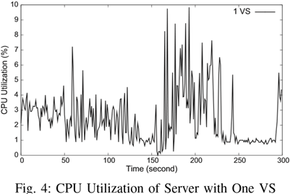
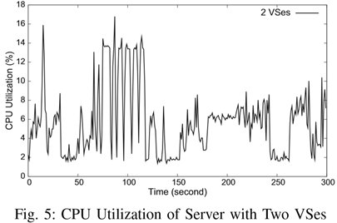
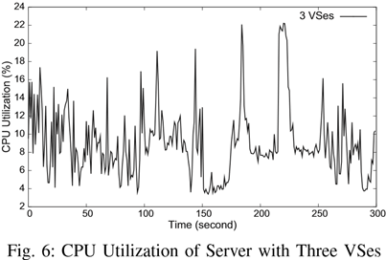
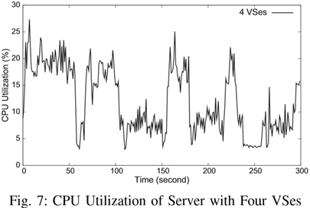
CPU Utilization :
CPU utilisation are 2.76%, 5.17%, 9.03%, 12.07%.
After adding VS,utilization increases 3.04%, 3.31%, 12.07%

Slide 21
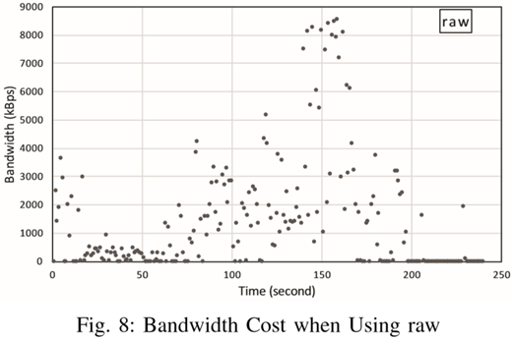
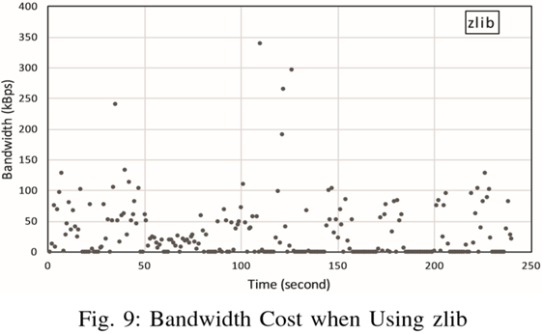
Bandwidth Requirement :
With raw method,highest bandwidth cost 8542.59 kbps and average value is 1200 kbps.
With zlib method,highest bandwidth cost 339.14 kbps and average value is 80 kbps.

Slide 22
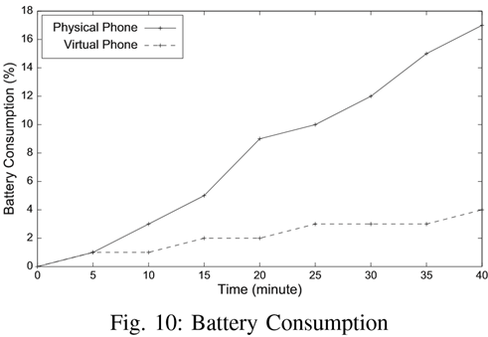
Battery Consumption :
Result is calculated for timespan of 40 minutes.
Physical device consumes more CPU resources than virtual smartphone which needs lots of battery.

Slide 23
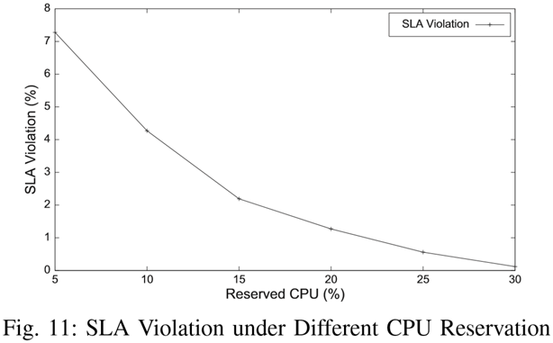
SLA Analysis :
Rate of SLA violation is less than 5% when the CPU reservation is 10%.
So the CPU reservation is set to 10% and is also used in ant colony optimization to solve VS assignment problem.

Slide 24
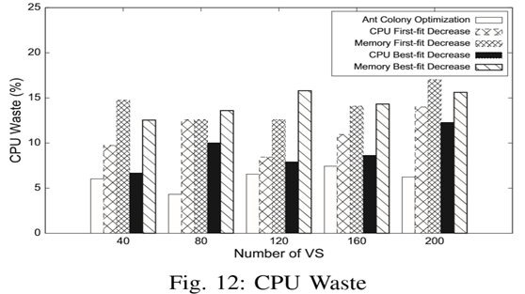
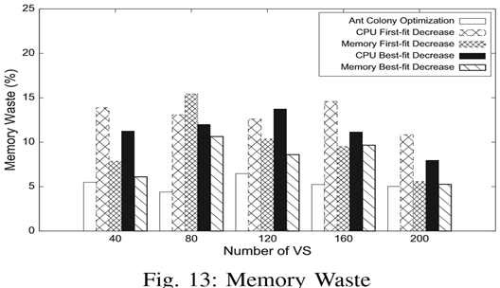
Virtual SmartPhone Assignment :
Ant colony optimization reduces the CPU Wastage.
Ant colony optimization also reduces Memory wastage.
With ant colony optimization ,VS assignment is much faster(Can assign 1000 VSes within 9 minutes)

Slide 25
Conclusion :
Mobile Application are controlled remotely,they are not constrained by processing power,memory & life limits of physical smartphone.
VSP migrates the burden of physical mobile device to remote server and provides a better user experience with low bandwidth.
Ant colony optimization helps us solve the VS assignment problem on multi-tenant platform and improves the utilization of server resource.

Slide 26
References:
M. Lai, J. Wang, T. Song, N. Liu, Z. Qi and W. Zhou, "VSP: A Virtual Smartphone Platform to Enhance the Capability of Physical Smartphone," 2016 IEEE Trustcom/BigDataSE/ISPA, Tianjin, 2016, pp. 1434-1441.
Y. Gao, H. Guan, Z. Qi, Y. Hou, and L. Liu, “A multi-objective ant colony system algorithm for virtual machine placement in cloud computing,” Journal of Computer and System Sciences, vol. 79, no. 8, pp. 1230–1242, 2013.
W. Huang, A. Ganjali, B. H. Kim, S. Oh, and D. Lie, “The state of public infrastructure-as-a-service cloud security,” ACM Comput. Surv., vol. 47, no. 4, p. 68, 2015

Slide 27
THANK YOU

